Slide 1
Accelerated Molecular Dynamics

Slide 2
aMD
Accelerated Molecular Dynamics is a bias potential introduced by the McCammon group at UCSD.
Doesn’t require information of where are the barriers, saddle points or even what type of configuration changes are expected or necessary to traverse through a particular barrier.
The shape of the added potential conserves the underlying shape of the real one.

Slide 3
AMD implementation in Amber
Implemented in both sander and pmend
iamd=2 - boosting only the torsional terms
iamd=1 - boost the whole potential
iamd=3 - whole potential and with a extra boost to the torsional

Slide 4
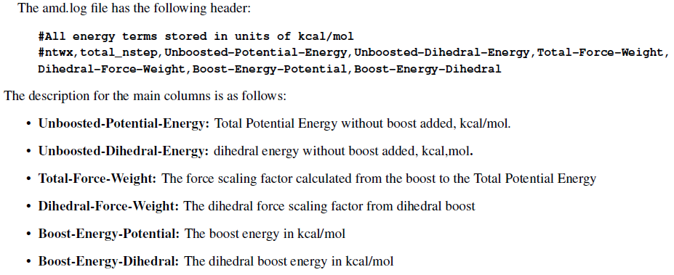
AMD output is saved in the amd.log. This file get written with the same frequency at which the corresponding snapshot being saved on the mdcrd file.

Slide 5
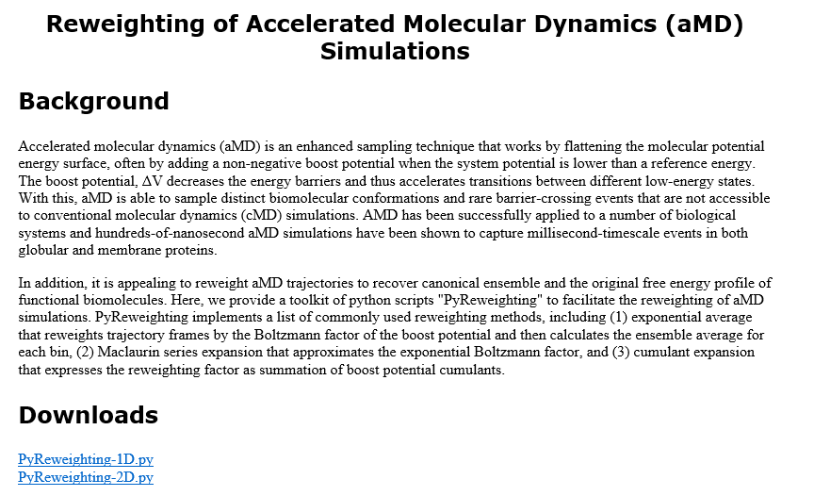
Reweighting
http://mccammon.ucsd.edu/computing/amdReweighting/

Slide 6
Preparing a system for aMD
Running aMD requires the definition of few parameters. AMD parameters are determined based on previous knowledge of the system, which is easily acquirable by a short regular MD simulation, from which the average values of the potential and torsion energy can be estimated.

Slide 7
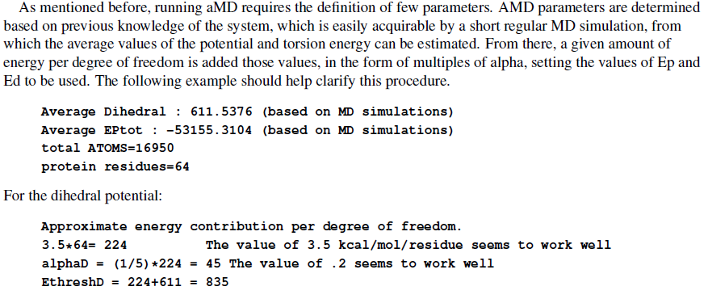
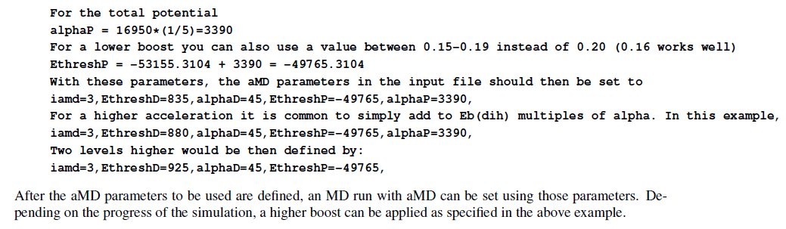
Preparing a system for aMD

Slide 8
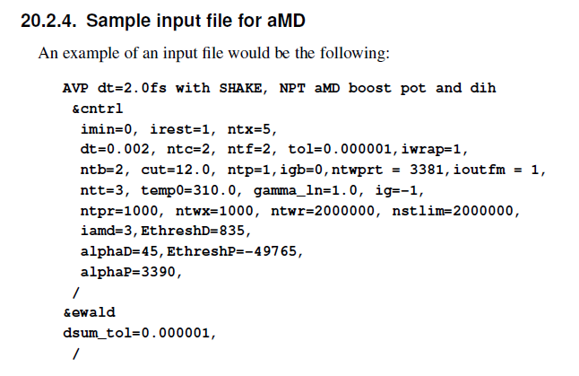
Sample input file for aMD

Slide 9
Gaussian Accelerated Molecular Dynamics
GaMD is a biomolecular enhanced sampling method that works by adding a harmonic boost potential to smooth the system energy surface.
The boost potential follows Gaussian distribution, which allows for accurate reweighting using cumulant expansion to the second order.
Has been demonstrated on simulations of alanine dipeptide, chignolin folding and ligand binding to the T4-lysozyme.
The free energy profiles obtained from reweighting of the GaMD simulations help identify distinct low energy states.

Slide 10
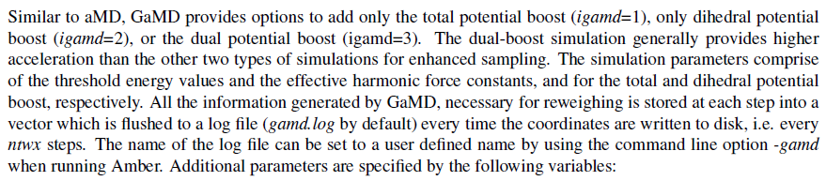
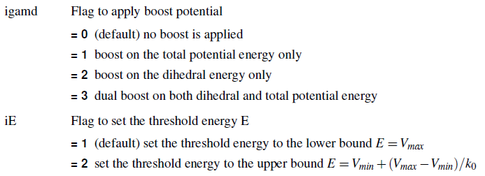
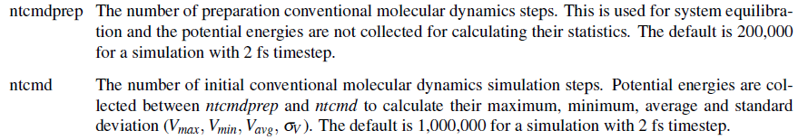

Slide 11
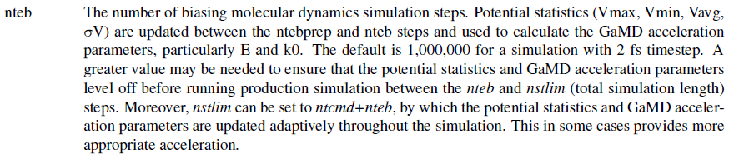
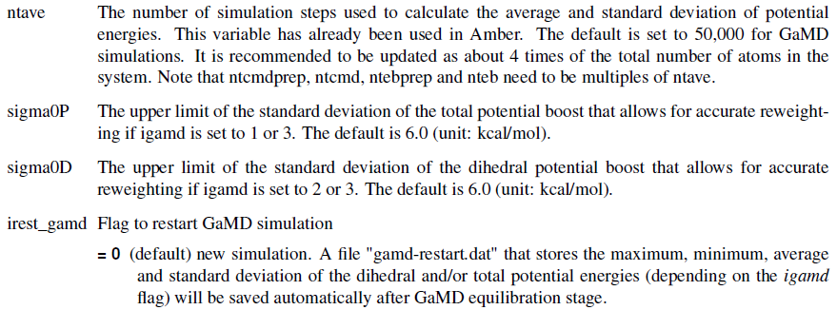

Slide 12
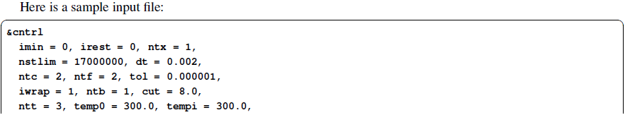
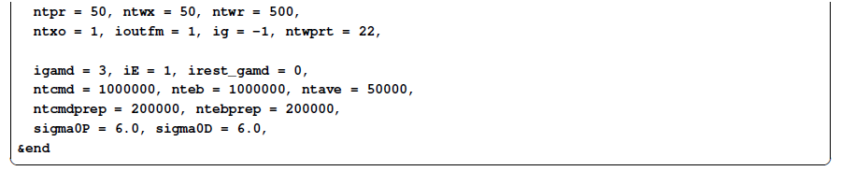
前面的步骤就按之前的，最后的production run加上自己的参数就好了

